Slide 1

Baseball Exploratory Analysis
Project 1
Grace Palmer, Devin Trapp, Ryan Vasquez, Alec Banerji, Ashley Paillet

Slide 2
Proposal and Goals (Ryan)
What stats correlate most closely with scoring runs?
BA & OPS
What unexpected trends can we uncover?
HR & SB

Slide 3
Creating a Workable DataFrame (Alec)
Cleaning
Renaming & removing columns
Refining timeframe by removing rows
Creating columns
Calculating averages to compare stats
Calculating correlation
Identifying strong positive and negative correlations

Slide 4
ANOVA (Ashley)

Slide 5
Histogram (Ashley)

Slide 6
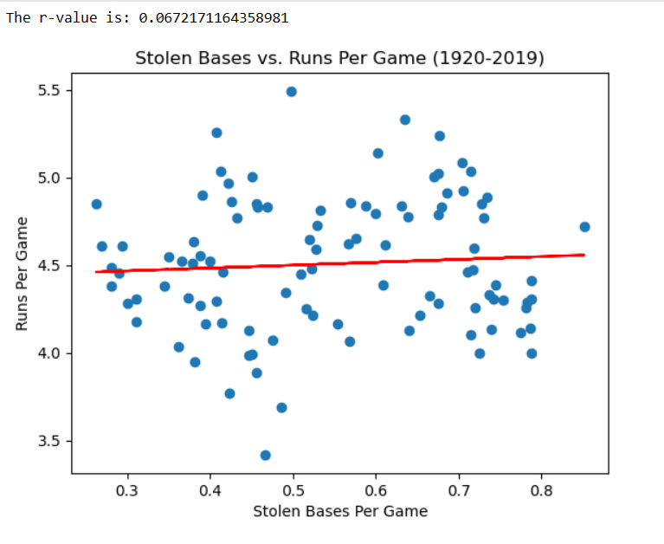
Scatter Plots & Linear Regression (Ryan)

Slide 7
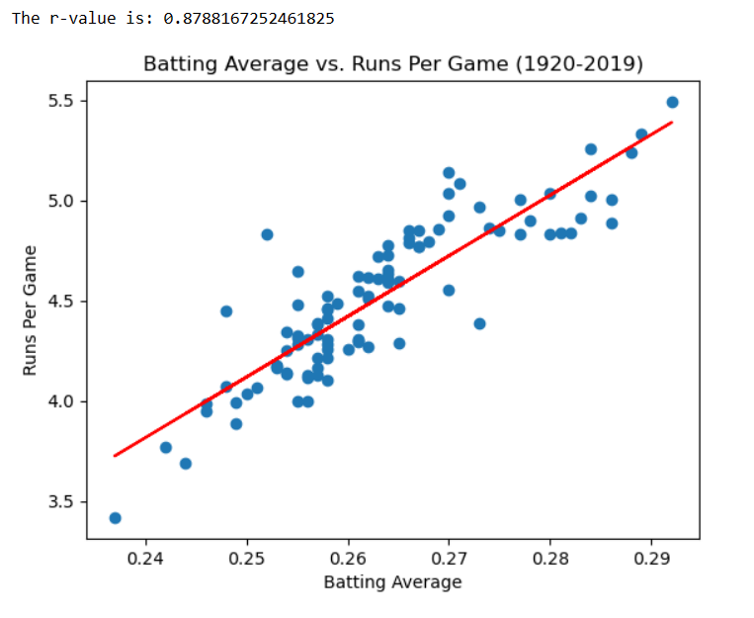
Scatter Plots & Linear Regression (Ryan)

Slide 8
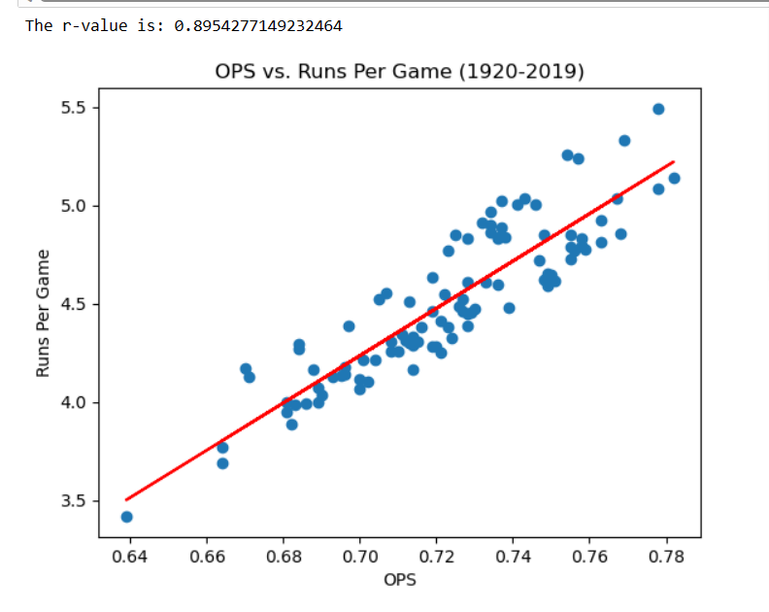
Scatter Plots & Linear Regression (Ryan)

Slide 9
Analyzing by Decade (Devin)
Binning
Reorganizing data by decade for further analysis and visualization

Slide 10
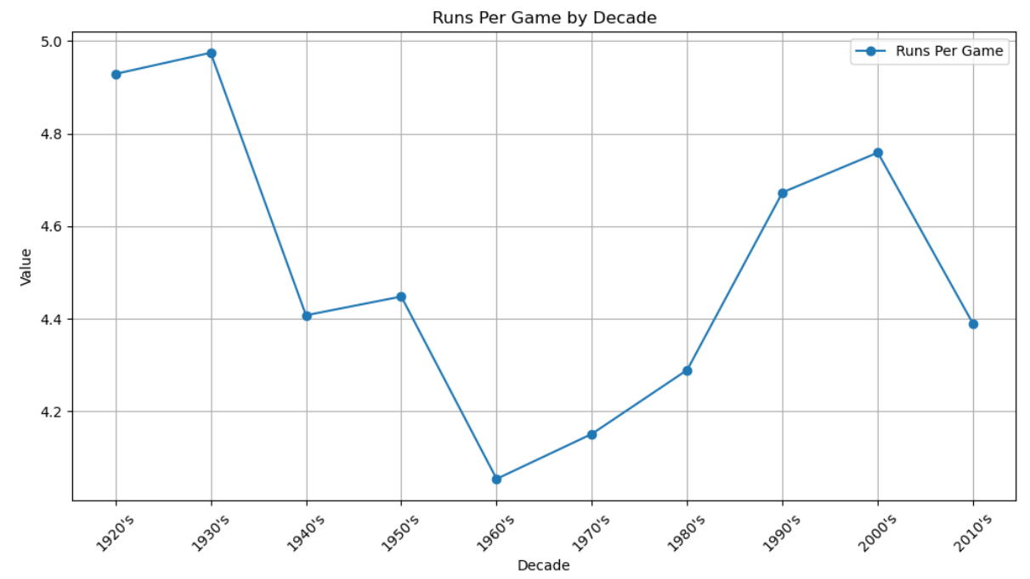
Analyzing by Decade (Devin)

Slide 11
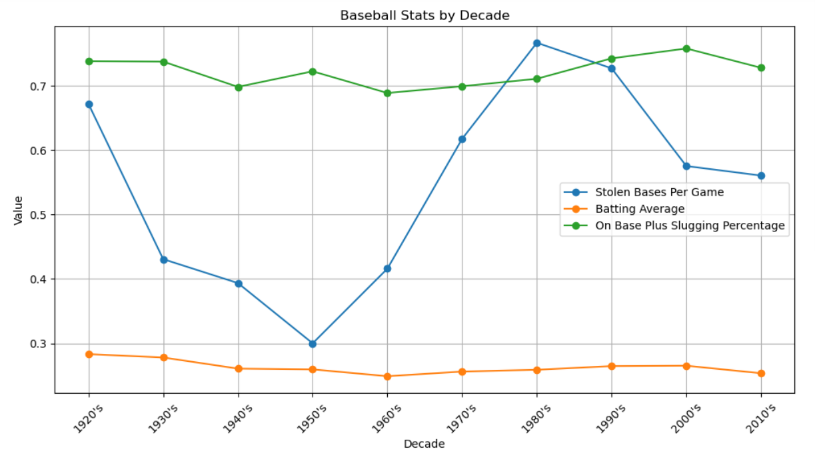
Analyzing by Decade (Devin)

Slide 12
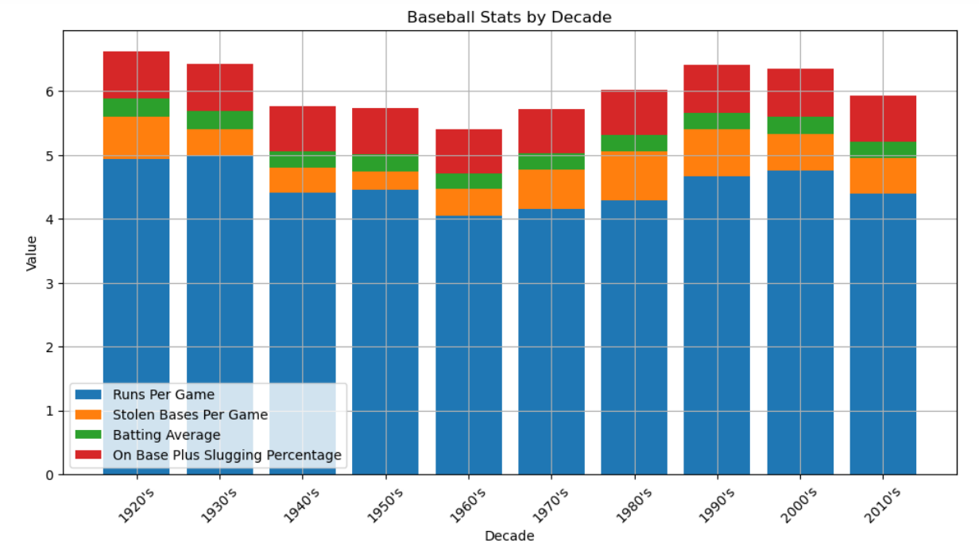
Analyzing by Decade (Devin)

Slide 13
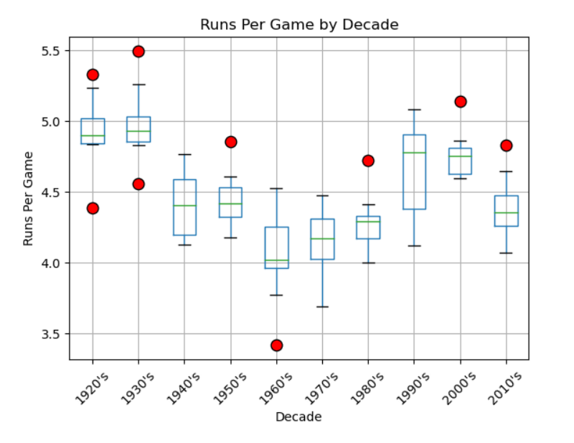
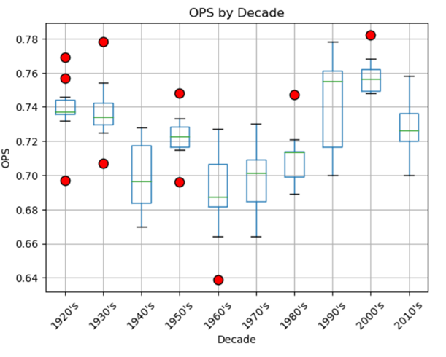
Box and Whisker Plots (Grace)

Slide 14
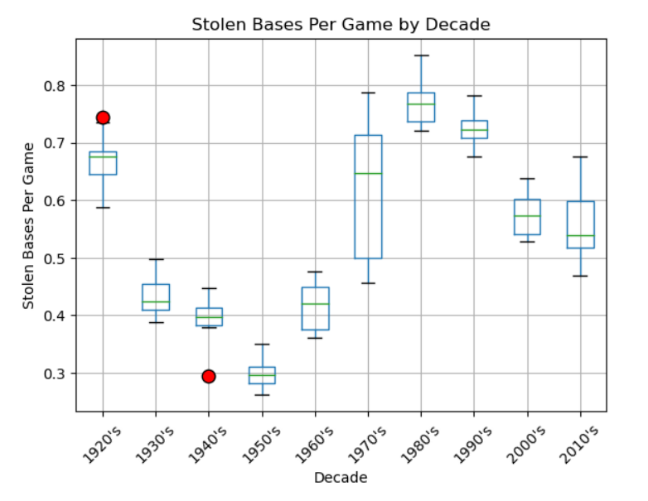
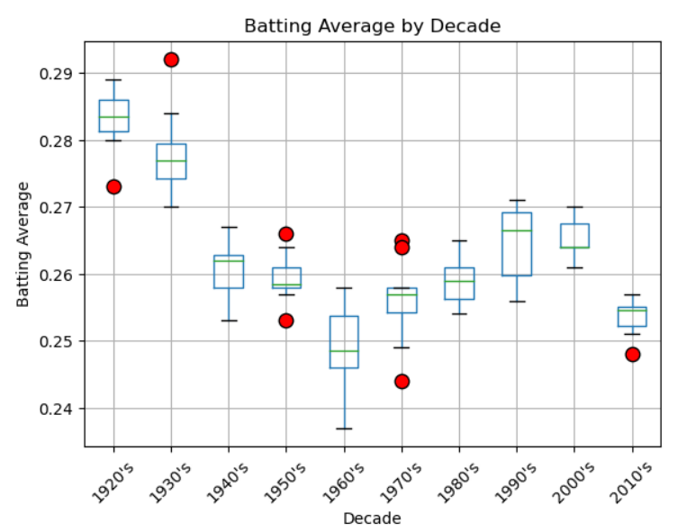
Box and Whisker Plots (Grace)

Slide 15
Conclusion (Grace)
BA and OPS correlate highly
Limitations of dataset
Further analysis opportunities

